Slide 1

Memory Layout

Slide 2
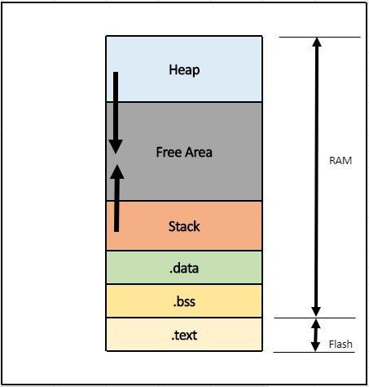
Memory layout

Slide 3
.data section
Initialized Global Variables/ Initialized Static Global Variables/ Initialized Static Local Variables
Load Location: FLASH
Run Location: RAM

Slide 4
.bss section
Uninitialized Global Variables/ Uninitialized Static Global Variables/ Uninitialized Static Local Variables
Load Location: Does not exist
Run Location: RAM

Slide 5
.rodata section
Global Const Variables
Load Location: FLASH
Run Location: FLASH

Slide 6
Stack
Section in RAM created at run time to hold local variables(initialized or uninitialized), also hold local const variables

Slide 7
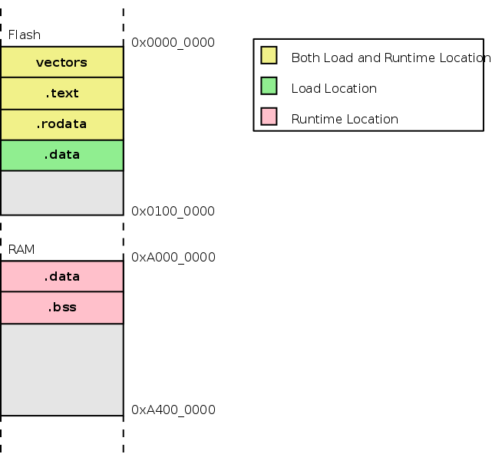

Slide 8
